Slide 1
“INTRODUCTION TO QUEUING SYSTEM”
Engr. Nazaruddin
Department of Biomedical Engineering, BUET(Khuzdar)
nazar@buetk.edu.pk
leC # 03, 04 & 05

Slide 2
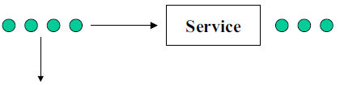
“Definition of a queueing system”
Customer arrivals
Departure of served customers
Departure of impatient customers
A queuing system can be described as follows:
"customers arrive for a given service, wait if the service cannot start immediately and leave after being served"
The term "customer" can be men, products, machines, ...

Slide 3
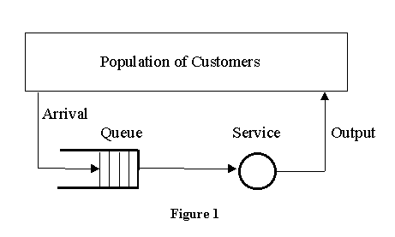
Elements/Components of Queuing System:
Figure 1: shows the elements of a single queue queuing system:

Slide 4
-Population of Customers:
It can be considered either limited (closed systems) or unlimited (open systems). Unlimited population represents a theoretical model of systems with a large number of possible customers (a bank on a busy street, a motorway petrol station). Example of a limited population may be a number of processes to be run (served) by a computer or a certain number of machines to be repaired by a service man. It is necessary to take the term "customer" very generally. Customers may be people, machines of various nature, computer processes, telephone calls, etc.

Slide 5
-Arrival
It defines the way customers enter the system. Mostly the arrivals are random with random intervals between two adjacent arrivals. Typically the arrival is described by a random distribution of intervals also called Arrival Pattern.

Slide 6
-Queue:
It represents a certain number of customers waiting for service (of course the queue may be empty). Typically the customer being served is considered not to be in the queue. Sometimes the customers form a queue literally (people waiting in a line for a bank teller). Sometimes the queue is an abstraction (planes waiting for a runway to land). There are two important properties of a queue: Maximum Size and Queuing Discipline.

Slide 7
Maximum Queue Size (also called System capacity) is the maximum number of customers that may wait in the queue (plus the one(s) being served). Queue is always limited, but some theoretical models assume an unlimited queue length. If the queue length is limited, some customers are forced to renounce without being served.
Queuing Discipline represents the way the queue is organized (rules of inserting and removing customers to/from the queue). There are these ways:
1) FIFO (First In First Out) also called FCFS (First Come First Serve) - orderly queue.
2) LIFO (Last In First Out) also called LCFS (Last Come First Serve) - stack.
3) SIRO (Serve In Random Order).
4) Priority Queue, that may be viewed as a number of queues for various priorities.

Slide 8
-Service:
It represents some activity that takes time and that the customers are waiting for. Again take it very generally. It may be a real service carried on persons or machines. Theoretical models are based on random distribution of service duration also called Service Pattern. Another important parameter is the number of servers. Systems with one server only are called Single Channel Systems, systems with more servers are called Multi Channel Systems.

Slide 9
-Output
It represents the way customers leave the system. Output is mostly ignored by theoretical models, but sometimes the customers leaving the server enter the queue again ("round robin" time-sharing systems).

Slide 10
Queue Parameters
Arrival Process
Queue Configuration
Service Mechanism
Queue Discipline
Number of Servers

Slide 11
1. Arrival Process
Determines how, when and where customer/jobs arrive to the system.
Important characteristic is the customers’/jobs’ inter-arrival times.

Slide 12
2. The Queue Configuration
The queue configuration
Specifies the number of queues
Single or multiple lines to a number of service stations
Their location
Their effect on customer behavior
Their maximum size (# of customer the queue can hold)

Slide 13
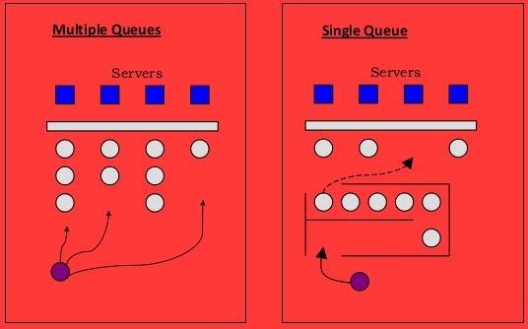
Example – Two Queue Configurations

Slide 14
3. The Service Mechanism
Can involve one or several service facilities with one or several parallel service channels (servers) - Specification is required.
2. The service provided by a server is characterized by its service time.
3. Specification is required and typically involves data gathering and statistical analysis.

Slide 15
4. Queue Discipline
Specifies the order by which jobs in the queue are being served.
-First Come First Served (FCFS)
-Shortest Processing Time (SPT)
-Earliest Due Date (EDD)
-Priority

Slide 16
Characteristics of a Queuing System
Four basic queuing system configurations
1. Single-Channel, Single-Phase System
Queue
Arrivals
Service Facility
Departures after Service

Slide 17
2. Single-Channel, Multiphase System
Queue
Type 1 Service Facility
Type 2 Service Facility
Departures after Service
Arrivals

Slide 18
3. Multichannel, Single-Phase System
Service Facility 1
Queue
Departures
Service Facility 2
Arrivals
after
Service Facility 3
Service

Slide 19
4. Multichannel, Multiphase System
Type 1 Service Facility 1
Type 2 Service Facility 1
Queue
Departures after Service
Arrivals
Type 1 Service Facility 2
Type 2 Service Facility 2

Slide 20
Applications of Queuing Theory In Health-Care

Slide 21
Why is queueing analysis helpful in healthcare?
Healthcare is riddled with delays. Almost all of us have waited for days or weeks to get an appointment with a physician or schedule a procedure, and upon arrival we wait some more until being seen. In hospitals, it is not unusual to find patients waiting for beds in hallways, and delays for surgery or diagnostic tests are common.
A simple example would be a healthcare clinic where patients walk in without appointments in an unpredictable fashion and require anything from a flu shot to the setting of a broken limb. This variability and the interaction between the arrival and service processes make the dynamics of service systems very complex. Consequently, it’s impossible to predict levels of congestion or to determine how much capacity is needed to achieve some desired level of performance without the help of a queueing model.

Slide 22
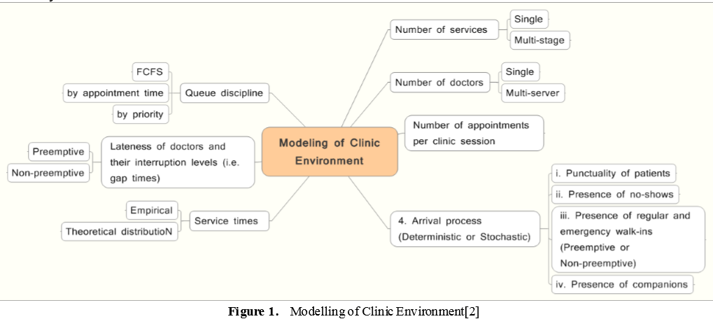
Applications of Queuing System In Healthcare :

Slide 23
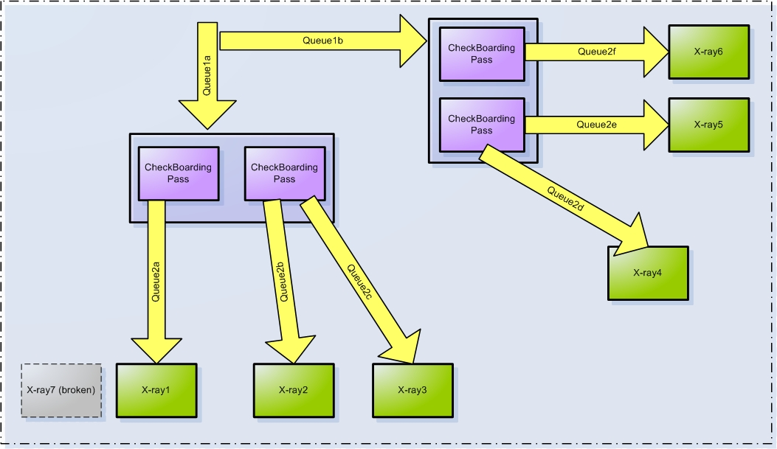

Slide 24
ASSIGNMENT
Q. Design a model of medical device by yourself using queuing theory and its parameters.

